Slide 1
Working with Javascript

Slide 2
Getting started with DOM.
What is Document Object Model (DOM)
The Document Object Model (DOM) is an application programming interface (API) for manipulating HTML documents.
The DOM represents an HTML document as a tree of nodes. The DOM provides functions that allow you to add, remove, and modify parts of the document effectively.
Note that the DOM is cross-platform and language-independent ways of manipulating HTML and XML documents.

Slide 3
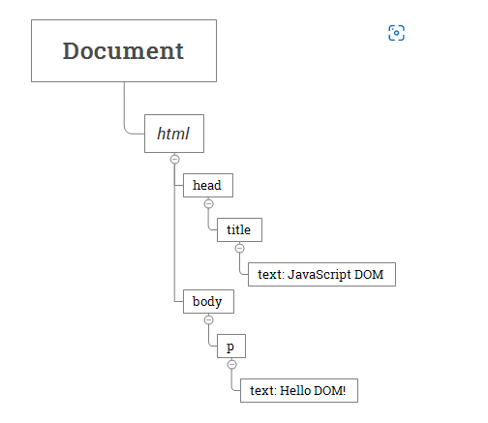

Slide 4
